Slide 1
Oracle Cloud Infrastructure Security
Der Praxis Workshop
Martin Berger
Stefan Oehrli

Slide 2
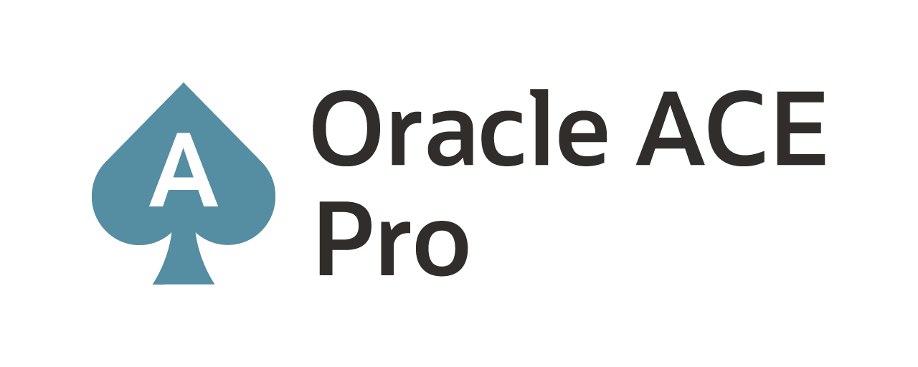
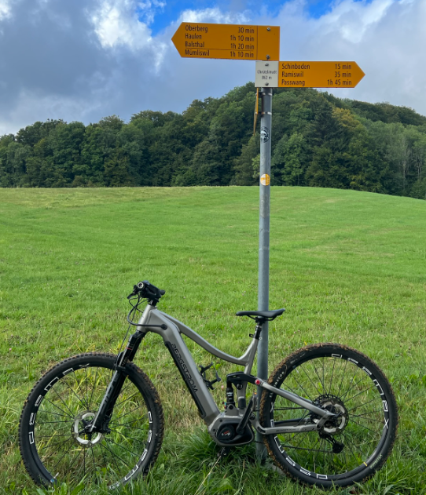
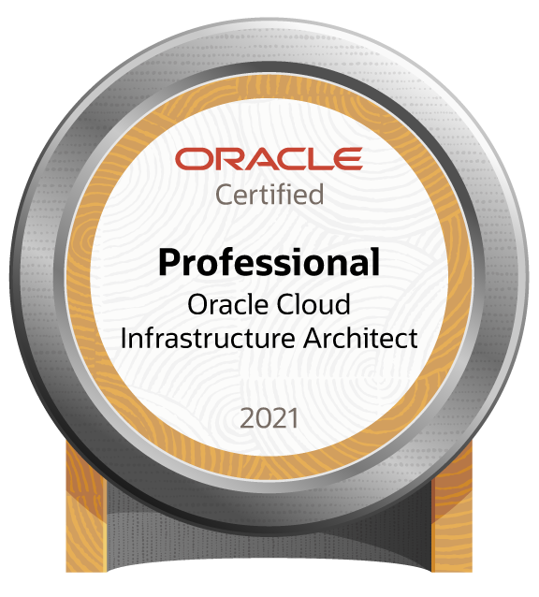




Martin Berger – Modern Data Platforms
Modern
Data
Platforms
stefan.oehrli@accenture.com
Tech Architecture Manager
Since 1998 working in IT
More than 22 years of experience in Oracle databases
Kestenholz / Jurasüdfuss / Switzerland
2 Junior-DBAs @ Home (8yrs & 10yrs)
Firefighter & E-Biker
Loves his companies' cultural values:
curiosity, doers, network, space, and together
Focus: Let’s go into the Cloud!
Co-author of the book The Oracle DBA (Hanser, 2016/07)
martinberger.com
@martinberger_ch

Slide 3

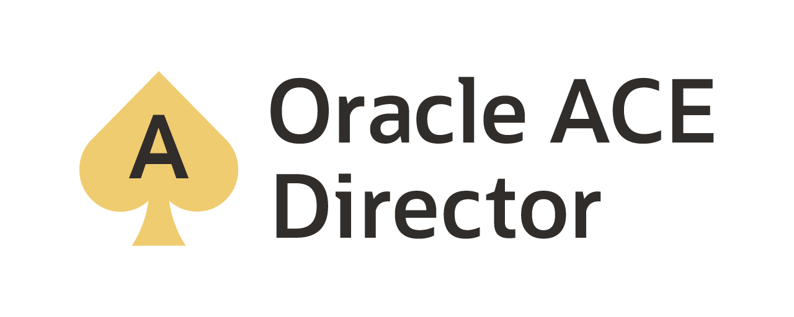
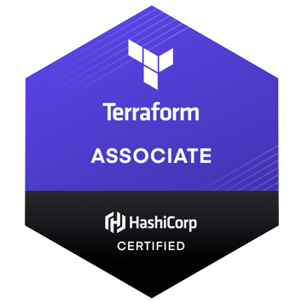
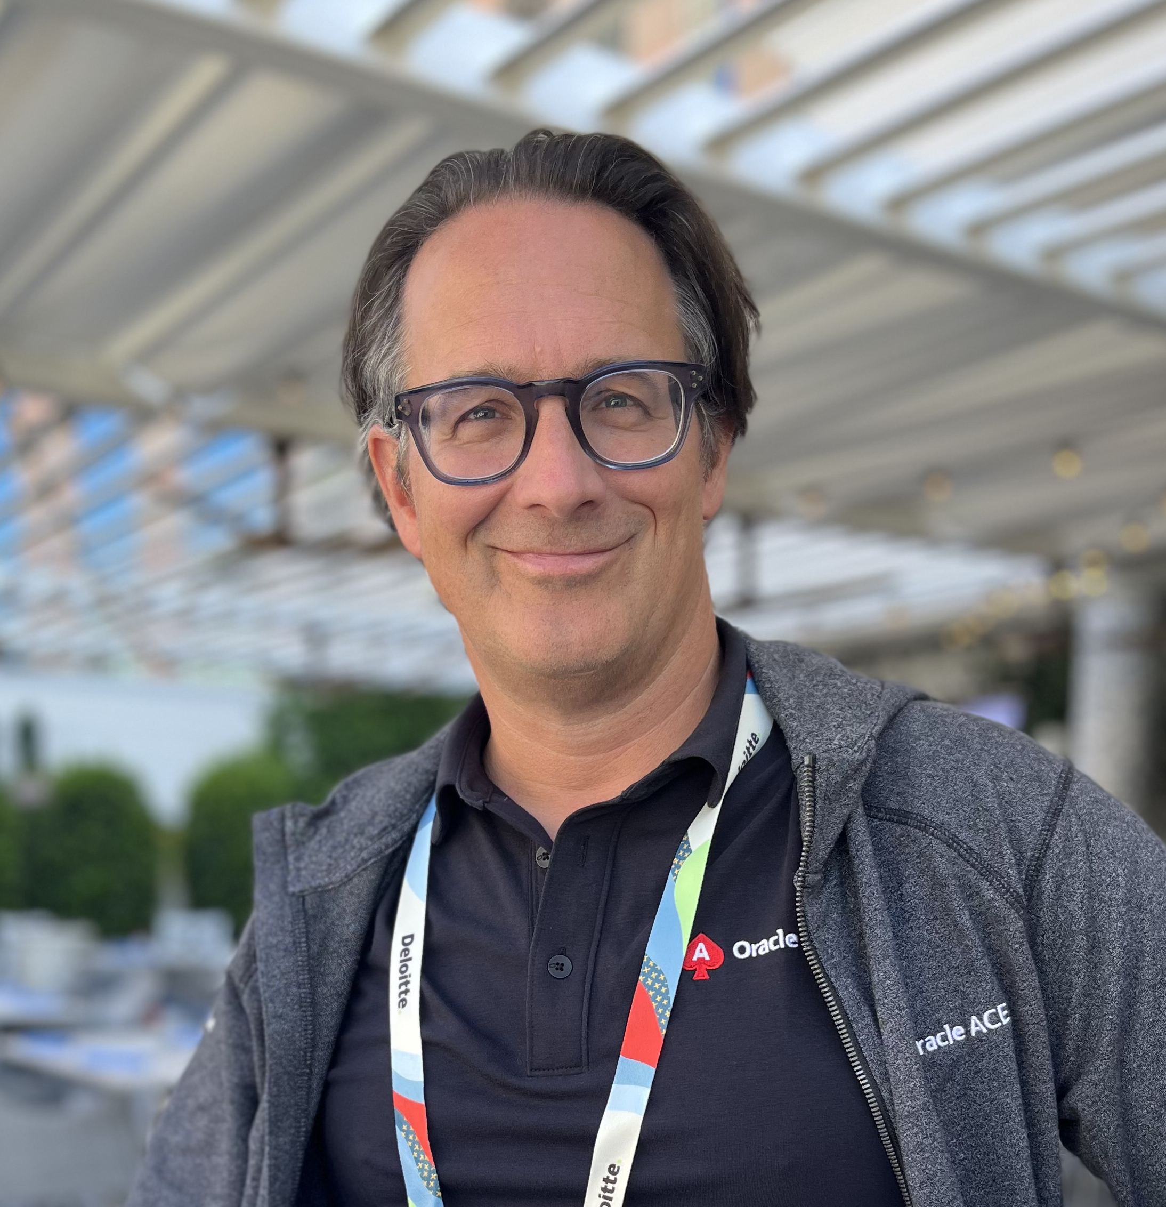
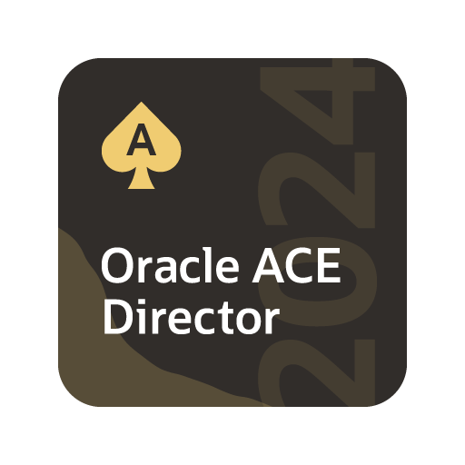

Stefan Oehrli – Modern Data Platforms
Modern
Data
Platforms
stefan.oehrli@accenture.com
Tech Architecture Manager
Since 1997 active in various IT areas
More than 25 years of experience in Oracle databases
Focus: Protecting data and operating databases securely
Security assessments and reviews
Database security concepts and their implementation
Oracle Backup & Recovery concepts and troubleshooting
Oracle Enterprise User and Advanced Security, DB Vault, …
Oracle Directory Services
Co-author of the book The Oracle DBA (Hanser, 2016/07)
oradba.ch
@stefanoehrli

Slide 4




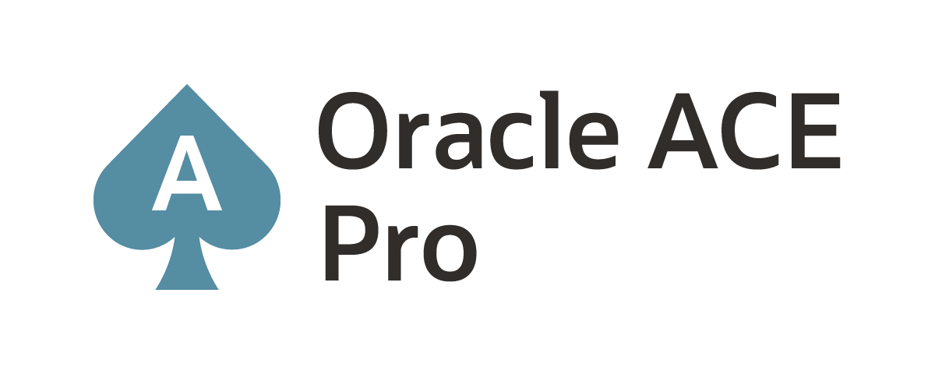



450+ technical experts helping peers globally
The Oracle ACE Program recognizes and rewards community members for their technical and community contributions to the Oracle community
3 membership tiers
Nominate yourself or someone you know:
ace.oracle.com/nominate
For more details on Oracle ACE Program:
ace.oracle.com
Connect:
aceprogram_ww@oracle.com
Facebook.com/OracleACEs
@oracleace
Oracle ACE Program Group

Slide 5


3 key benefits
Modern Data Platforms VISON & MISSION
WHY? We are the game changer for our client's data platform projects
HOW? Maximum automation, maximum efficiency, maximum quality!
WHAT? We build innovative data platforms based on our blueprints and licensable assets and tools.
1 Architecture expertise from hands-on projects
2 Delivery of tailor-made data platforms
3 Integrated Teams - Like a rowing team, perfect alignment and interaction.
Tools and Blueprints
Continuous Optimization
Expertise & Light Towers
Key enabler for the implementation of modern data platforms at a high speed and quality.
Tools and Blueprints are continuously optimized to the customer and project’s needs.
Expert group for modern data platforms from technical implementation to project management and organization

Slide 6
SQL Firewall
1
Introduction
2
SQL Firewall
A new approach to protect your data.
3
CLI Management
4
GUI Management
5
Reporting, Audit and Alerts
6
Licensing
7
Challanges
8
Conclusion

Slide 7
Introduction
1
What about the Database Security?

Slide 8
Thank You

